Slide 1
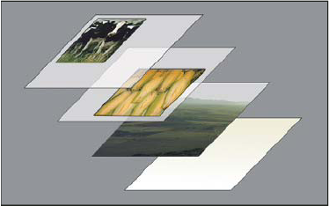
Graphical Elements
Graphical Enhancements
Photoshop layers representation - Transparent areas on a layer let you see layers below. Adobe Stock
Notes:
Photoshop layers representation
Transparent areas on a layer let you see layers below.

Slide 2
After the quiz is completed
Graphical Enhancements begins
3.1 Practice optimizing and combining images.
3.2 Show how layers, masks and selections can create new image compositions from multiple sources.

Slide 3
About Layers
The Layers panel in PSD, AI, lists all layers, layer groups, and layer effects in an image. The layers panel is used to show and hide layers, create new layers, and work with groups of layers. You can access additional commands and options in the Layers panel menu.
In Photoshop it is all about the layers, building composites and combining many images together to create a informational or expression of thought. Layers can hold video content too!
Photoshop layers are used for non-destructive editing “an adjustment layer holds color or tonal adjustments that affect the layers below it. Rather than edit image pixels directly (which is termed a destructive mode), you can edit an adjustment layer and leave the underlying pixels unchanged and fully editable in the future with layers intact.

Slide 4
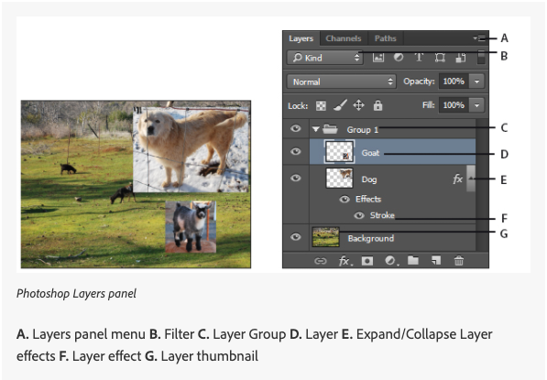
Layers Panel
Notes:
Layer panel in PSD and similar in AI. XD is different we will discuss that in the app

Slide 5
About layer and vector masks
You can create two types of masks:
Layer masks are resolution-dependent bitmap images that are edited with the painting or selection tools.
You can edit a layer mask to add or subtract from the masked region. A layer mask is a grayscale image. The areas you paint in black are hidden, the areas you paint in white are visible, and the areas you paint in shades of gray appear in various levels of transparency.
Vector masks are resolution independent and are created with a pen or shape tool.
Layer and vector masks are non-destructive and editable in the future.
A vector mask creates a sharp-edged shape

Slide 6
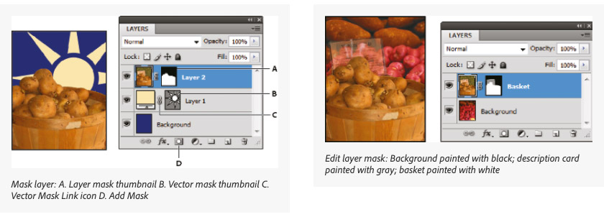
Layers Panel (cont’d)
The layers panel in PSD and are similar in AI.
XD layers work differently we will discuss that in the app
Notes:
The layers panel in PSD and are similar in AI.
XD layers work differently we will discuss that in the app

Slide 7
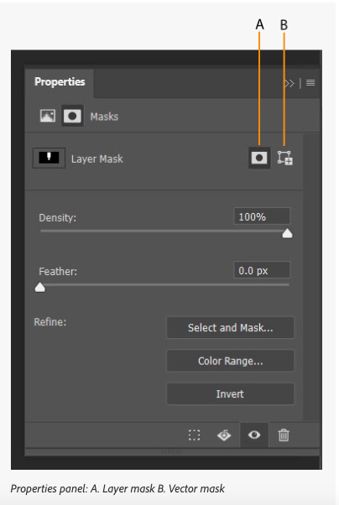
Layer options in the properties Panel
Types of layer mask can be setup through the properties panel in PSD and similar in AI. XD layers work differently we will discuss that in the app
Notes:
Types of layer mask can be setup through the properties panel in PSD and similar in AI. XD layers work differently we will discuss that in the app

